Slide 1


INFORMATION COMMUNICATION TECHNOLOGY
Spreadsheet software
- Functions

Slide 2
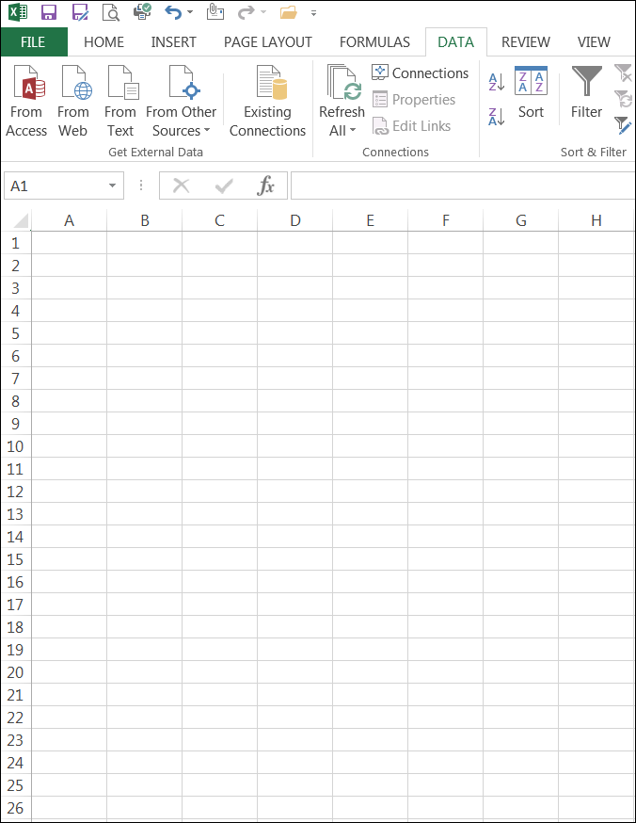
Revision - terminology
Let’s revise some terms that we covered last lesson.
Cell
Active cell
Column
Formula
Formula bar
Row
Spreadsheet

Slide 3
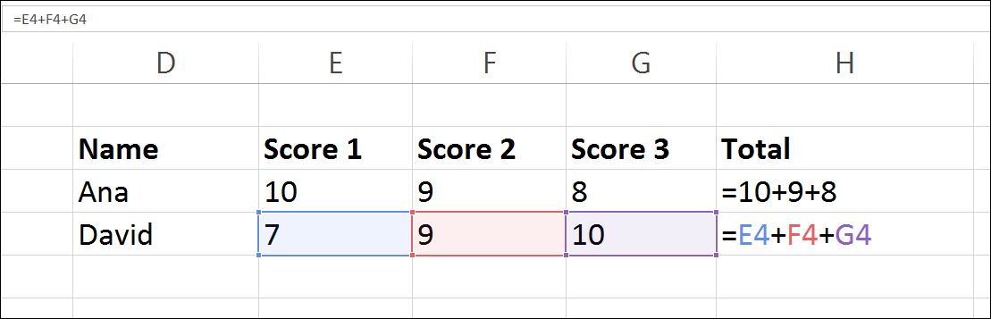
Cell referencing
Rather that typing numbers into the formula it is better to type in the cell address where the number is located.
The cell address is referenced in the formula.
The practise of using cell addresses in formulas is known as cell referencing.

Slide 4
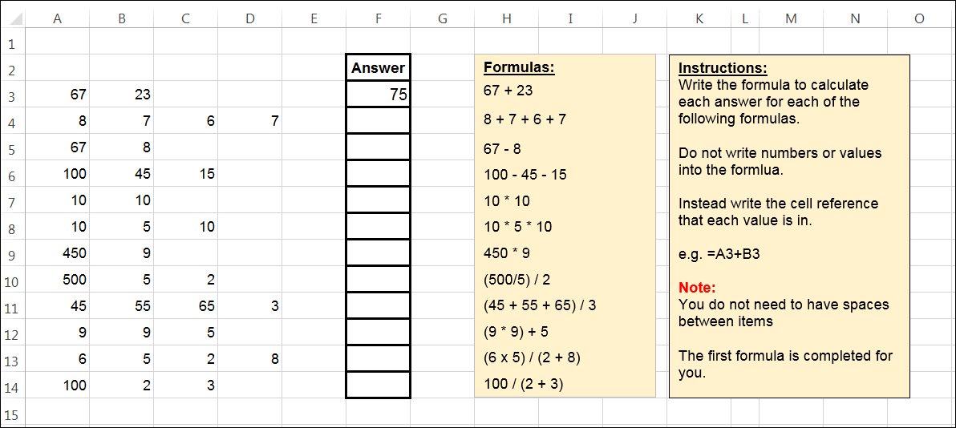
Activity – cell referencing
Tip:
Remember formulas always start with an = sign
Download the cell referencing spreadsheet.
Complete each calculation by creating formulas using cell referencing.

Slide 5
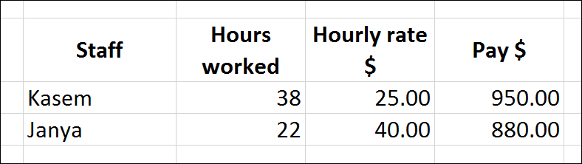
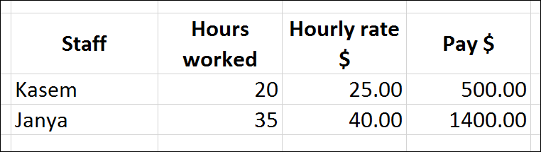
Cell referencing - advantages
One of the advantages of cell referencing
Once the formulas are created a spreadsheet can be re-used over and over again with new values.
There is no need to change the formula.

Slide 6

Activity – think, pair, share
Think:
What are other advantages of using cell referencing when writing formulas?
Pair:
Discuss this with the students sitting next to you.
Share:
Share your responses with the rest of the class.

Slide 7
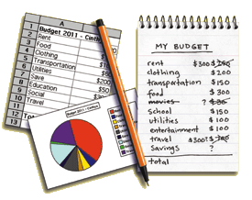
Spreadsheet advantages
Why use a spreadsheet to perform calculations compared to completing them manually on paper?
Quicker
Re-use spreadsheet
Edit values easily
Save file on hard drive
Email spreadsheet
Save trees
Others

Slide 8
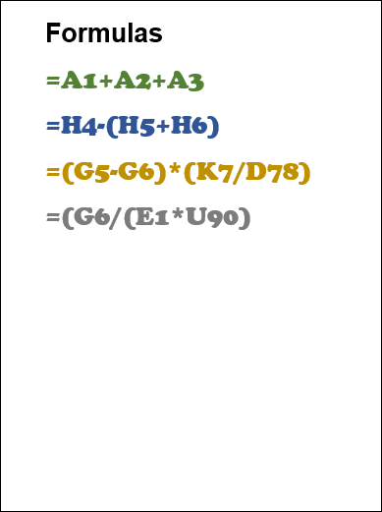
Formulas - definitions
A spreadsheet formula is a mathematical equation used to perform calculations.
Formulas can contains values or cell references.
=45+67+5
=(A6+A7)/A8
Formulas contain operators which are used to perform the calculations.
Examples of operators include:
+ - * / < > = ( )

Slide 9
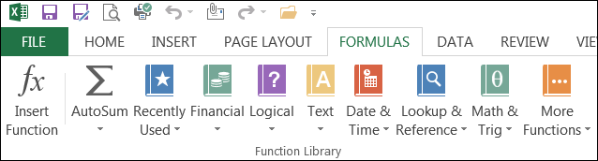
Functions - definition
Activity:
Open a spreadsheet and click on the formulas icon. You can then explore all the groups of functions available.
A function is a pre-built formula.
Calculations that are performed regularly have been pre-programmed into spreadsheet software.
The operators for a particular calculation have been replaced with a function name.
There are over 400 functions pre-built into a spreadsheet.
Functions are used in formulas.

Slide 10
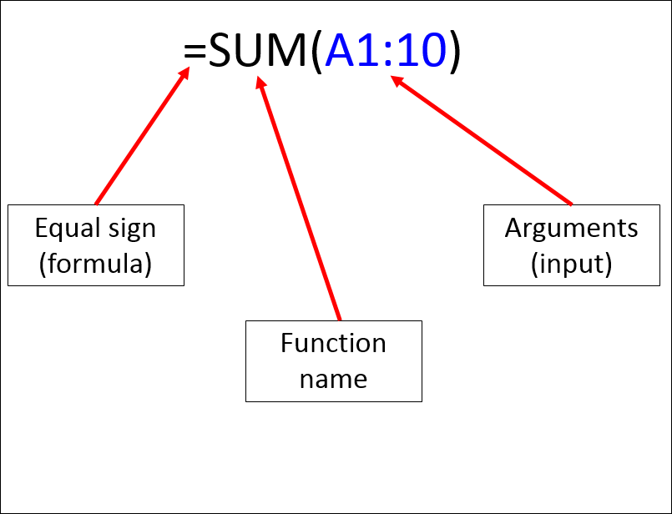
Functions - format
To use a function in a formula the following information needs to be included:
= sign
Function name
Arguments
Arguments are inputs or information needed to perform the calculation.
The arguments required vary depending on the function.
The arguments used in SUM function is a cell range.

Slide 11
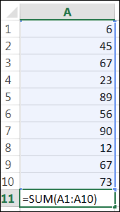
Functions – cell ranges
Both formulas below produce the same answer:
=A1+A2+A3+A4+A5+A6+A7+A8+A9+A10
=SUM(A1:A10)
The cell range (A1:A10) is used as an argument (input) for the formula.
The ‘range’ indicates the first cell and the last cell of all the cells to be included in the calculation.
A ‘range’ is a shortcut to listing every cell reference in a formula – it saves effort and time!

Slide 12
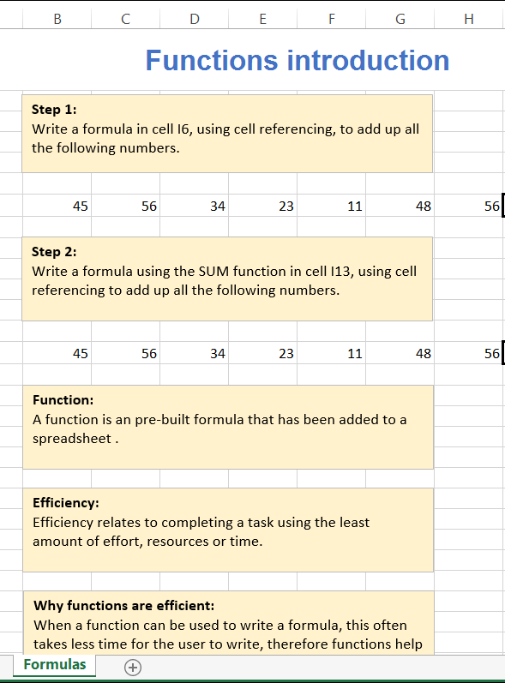
Activity – introduction to functions
Efficiency
Completing a task using the least amount of effort, resources or time
Download the spreadsheet introduction to functions.
Complete the two formulas – one using a list of all the cells and one using a SUM function.
Think Describe the term efficiency?
How does using a function improve efficiency?
Pair Discuss these two questions with the students around you.
Share Report your findings with the group.

Slide 13
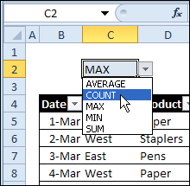
Functions – statistical functions
Statistical functions include:
SUM Adds up the numbers in the range.
e.g. =SUM(A1:A10)
COUNT Counts the number of cells that contains a number in the range. e.g. =COUNT(A1:A10)
AVERAGE Calculates the average of the numbers in each cell. e.g. =AVERAGE(A1:A10)
MIN Calculates the lowest number in the range.
e.g. =MIN(A1:A10)
MAX Calculates the highest number in the range.
e.g. = MAX(A1:A10)

Slide 14
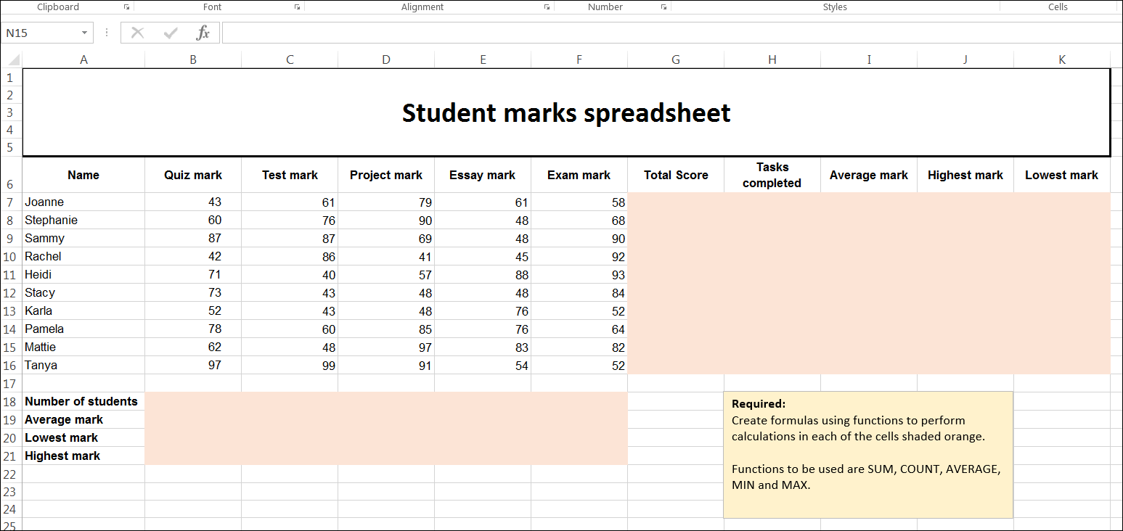
Activity – statistical functions
Download the spreadsheet file from eLearn (Statistical functions).
Complete all of the required formulas using statistical functions.

Slide 15
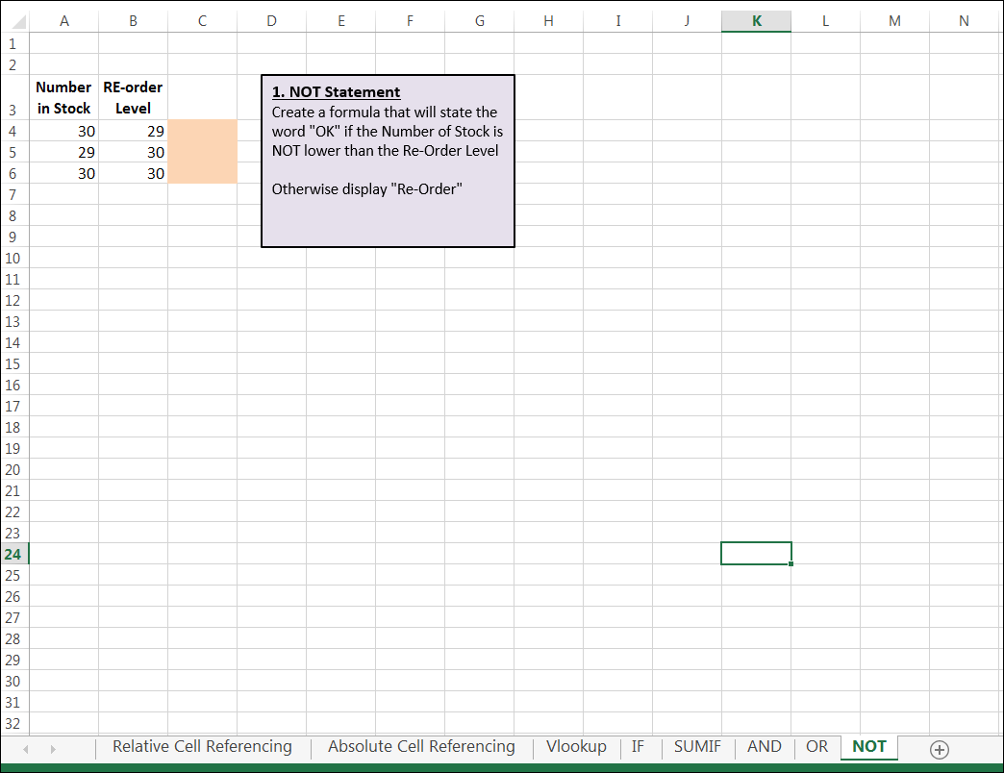
Workbook & worksheets
Workbook Spreadsheet files are also known as workbooks.
A workbook can contain many worksheets.
Worksheet A worksheet is a single page within a workbook.
A worksheet can be selected by clicking on relevant tab at the bottom of the page.
Or added by clicking the + symbol

Slide 16

Functions – logical functions
Logical functions are calculations that only return two answers – true or false.
They are often used to ask a question?
Logical functions include:
IF
AND
OR
The most used logical function is the IF function.

Slide 17
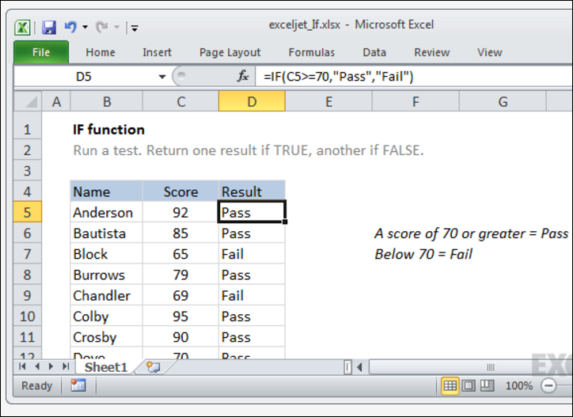
Functions – IF function
IF functions use the following format:
=IF(Condition, True, False)
They require three arguments (or inputs):
A condition or rule e.g. C5>10
What to do if the condition is true
What to do if the condition is false
Example:
=IF(C5>70,”Pass”,”Fail”)

Slide 18
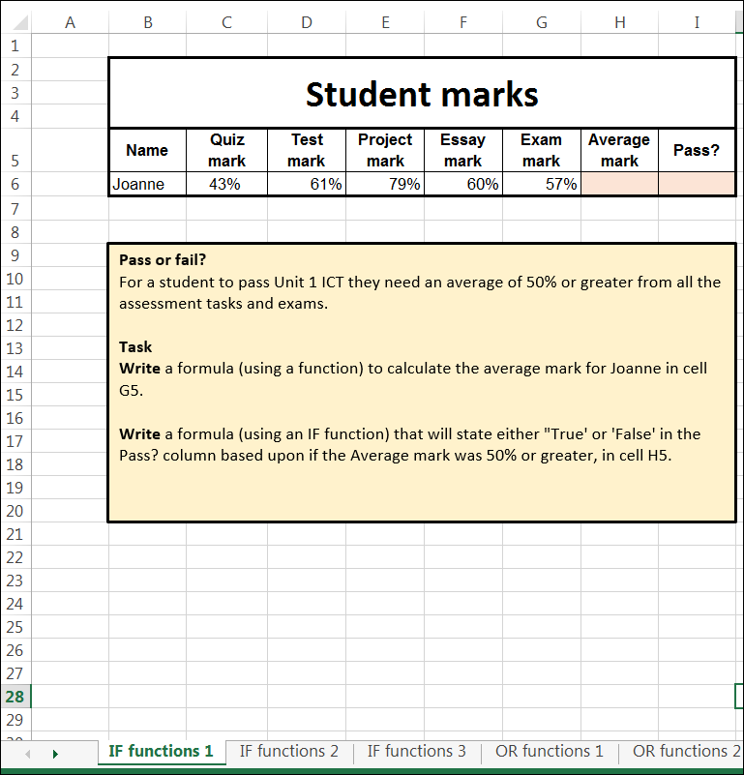
Activity – Logical functions
Download the logical functions spreadsheet from eLearn.
The workbook has seven worksheets.
Complete the calculations on the first three worksheets.

Slide 19
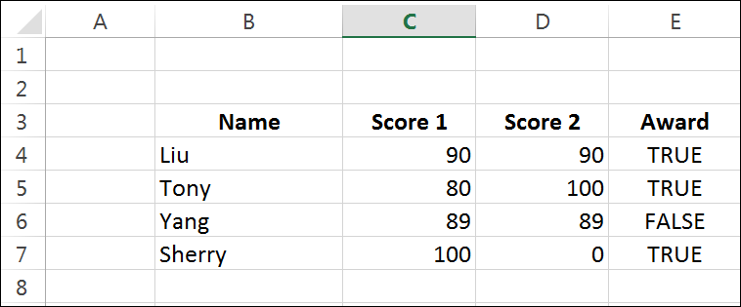
Functions – OR function
OR functions check to see if a condition is meet in one or more cells.
OR functions use the following format:
=OR(Condition 1, Condition 2)
Example:
=OR(C4>=90, D4>=90)
If either condition is true, then TRUE will displayed.

Slide 20
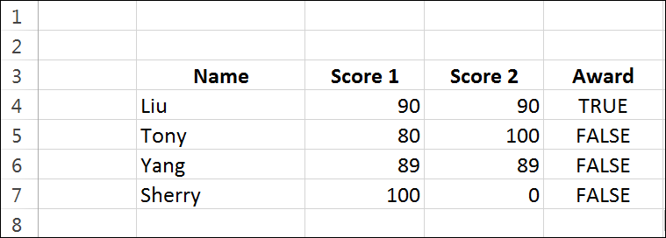
Functions – AND function
AND functions check to see if a condition is meet in ALL the cells.
AND functions use the following format:
=AND(Condition 1, Condition 2)
Example:
=AND(C4>=90, D4>=90)
If both conditions are true, then TRUE will displayed.

Slide 21
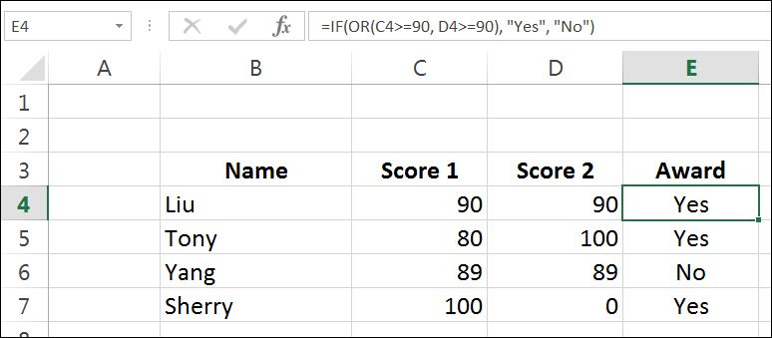
Combining IF with OR
By combining an OR function with an IF function you can produce output other than TRUE or FALSE.
=IF(OR(Condition 1, Condition 2), True, False))
=IF(OR(C4>=90, D4>=90), “Yes”, “No”)

Slide 22
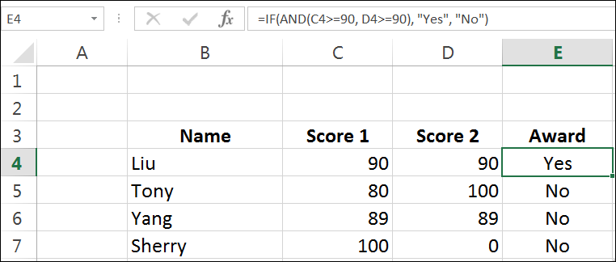
Combining IF with AND
By combining an AND function with an IF function you can produce output other than TRUE or FALSE.
=IF(AND(Condition 1, Condition 2), True, False))
=IF(AND(C4>=90, D4>=90), “Yes”, “No”)

Slide 23
Activity – Logical functions
Download the logical functions spreadsheet from eLearn.
The workbook has seven worksheets.
Complete the calculations on the last four worksheets.

Slide 24

Write workbook notes
Complete workbook notes on page 2:
Logical functions
Function
Cell range
Statistical functions
Workbook
Worksheet

Slide 25
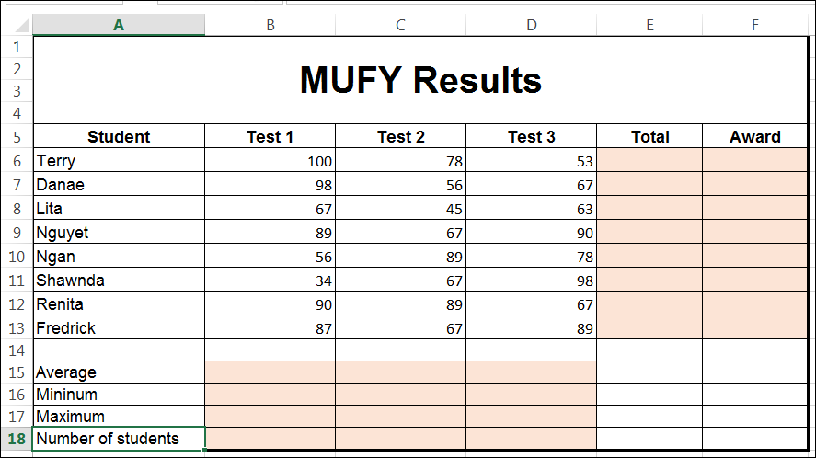
Post-class activity
Complete and submit the post class activity on eLearn.

